Slide 1

Files: open; Read; Search
Python Programming | Loops, string, files, list, dictionaries and tuples
Course: Python Programming | Chapter: Loops, string, files, list, dictionaries and tuples | Bachelor of Computer Science and Engineering
DISCOVER · LEARN · EMPOWER
Notes:
Welcome everyone to today's session on file handling in Python. We are diving deep into how to open, read, and search within files. This is a critical skill for any engineer dealing with data persistence. Let's begin by understanding the core outcomes we will achieve today.

Slide 2
Course Outcomes
SLIDE 2 / 14
Course Outcome
CO | BT LEVEL | DESCRIPTION
CO1 | BT1 | Understand the syntax, control structures, and basic constructs of Python programming language
CO2 | BT3 | Apply functions, modules, and exception handling for modular program development
CO3 | BT3 | Implement data structures including lists, tuples, dictionaries, and sets for efficient data processing
CO4 | BT4 | Analyze and manipulate files, strings, and perform data handling operations
CO5 | BT5 | Design and develop real-world applications integrating multiple Python concepts
Chandigarh University
2 / 14
Notes:
Today's lecture directly addresses two specific course outcomes. First, we will implement data structures like lists to store file contents efficiently. Second, we will analyze and manipulate files to perform essential data handling operations. These skills are foundational for real-world engineering applications.

Slide 3
Learning Objectives
SLIDE 3 / 14
Learning Outcomes
1
Analyze the necessity of file modes when opening data sources
2
Demonstrate the correct syntax for opening and closing file objects
3
Evaluate different methods for reading content from text files
4
Apply search algorithms to locate specific strings within file data
5
Implement error handling for common file operation exceptions
Chandigarh University
3 / 14
Notes:
By the end of this lecture, you will be able to analyze why file modes matter before writing a single line of code. You will demonstrate the correct syntax for opening files and evaluate the best methods for reading data. We will also apply search algorithms to find specific strings and implement error handling for robust programs.

Slide 4
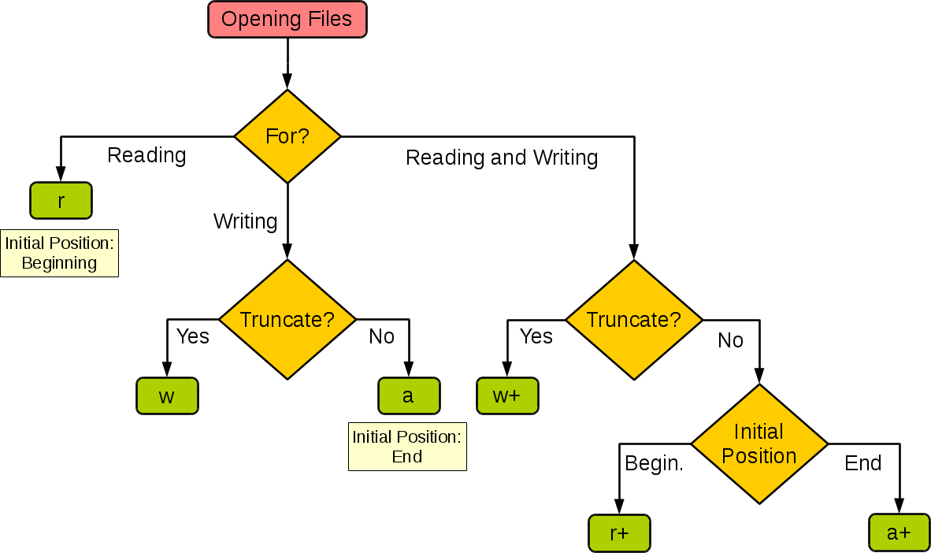
Lecture
SLIDE 4 / 14
The open() Function and Modes
SYNTAX REQUIRES TWO ARGUMENTS
filename string and mode string for access type
• The open() function returns a file object required for all subsequent operations
• Mode 'r' opens for reading only and fails if the file does not exist
• Mode 'w' opens for writing and truncates existing content to zero length
• Mode 'a' opens for appending data to the end of the existing file
• Mode 'r+' opens for both reading and writing without truncating existing data
• Always close files using the close() method to release system resources
python - Difference between modes a, a+, w, w+, and r+ in the built-in open() function - Stack Overflow
Chandigarh University
4 / 14
Notes:
Think of the open() function as unlocking a door; the mode determines whether you can just look inside or also rearrange furniture. If you use 'w' mode on a file with 100 lines, those 100 lines vanish instantly. Always remember to close files, otherwise, your data might not be saved to the disk properly.

Slide 5

Reading Files
SLIDE 5 / 14
read() Method
1
The read() method loads the entire file content into a single string variable
2
Calling read() with an integer argument reads that specific number of bytes
3
This method is efficient for small files but consumes memory for large ones
4
The read() method returns an empty string when the end of file is reached
5
Use read() when you need to process the entire file as one block of text
6
Remember that read() moves the file pointer to the very end of the file
7
Subsequent reads will return nothing unless the pointer is reset to the start
Source: miro.medium.com
Chandigarh University
5 / 14
Notes:
The read() method is like scooping up the entire contents of a bucket into a single bowl. If you specify a number, say 50, it only scoops the first 50 characters. A common pitfall is calling read() twice without resetting the pointer, which results in an empty string the second time.

Slide 6

Reading Files
SLIDE 6 / 14
readline() Method
1
The readline() method reads a single line from the file including the newline character
2
It returns an empty string only when the end of the file is encountered
3
This method is useful for processing files line-by-line without loading everything
4
Calling readline() repeatedly allows sequential access to every line in the file
5
The file pointer advances to the beginning of the next line after each call
6
Use readline() when you need to parse structured data line by line
7
Be careful with trailing newline characters when processing the returned string
Source: cdn.svgator.com
Chandigarh University
6 / 14
Notes:
Imagine reading a book one page at a time; readline() does exactly that for files. It grabs one line and leaves the rest for later. This is memory efficient because you don't load the whole book into your head at once. However, remember that the newline character is included in the string you get back.

Slide 7
Reading Files
SLIDE 7 / 14
readlines() Method
1
The readlines() method reads all lines and returns a list of string elements
2
Each element in the list corresponds to one line from the original file
3
This method automatically strips the newline character from the end of each line
4
It is convenient for iterating over lines using a for loop immediately
5
Use readlines() when you need random access to specific lines later in the code
6
This method is less memory efficient than readline() for very large files
7
The resulting list can be manipulated using standard list operations and indexing
Chandigarh University
7 / 14
Notes:
The readlines() method is like taking a photo of every page and putting them in a stack of index cards. You get a list where each card is a line of text. This is great if you need to access the 5th line later without reading the first four again. Just be cautious with huge files as it loads everything into memory.

Slide 8

Lecture
SLIDE 8 / 14
Searching for Strings in Files
1
Searching involves iterating through lines to find a specific target string pattern
2
The 'in' operator checks if a substring exists within a line of text
3
A boolean True is returned if the search string is found in the line
4
A boolean False is returned if the search string is not present in the line
5
Use a flag variable to track if the search was successful across the whole file
6
Stop searching immediately once the target string is found to save processing time
7
Case sensitivity matters; 'Python' is not the same as 'python' in a search
Source: static.vecteezy.com
Chandigarh University
8 / 14
Notes:
Searching is like looking for a specific word in a dictionary. You check each line and ask, 'Is this word here?' If you find it, you can stop looking. A common mistake is forgetting that 'Python' and 'python' are different strings. Always consider case sensitivity in your search logic.

Slide 9
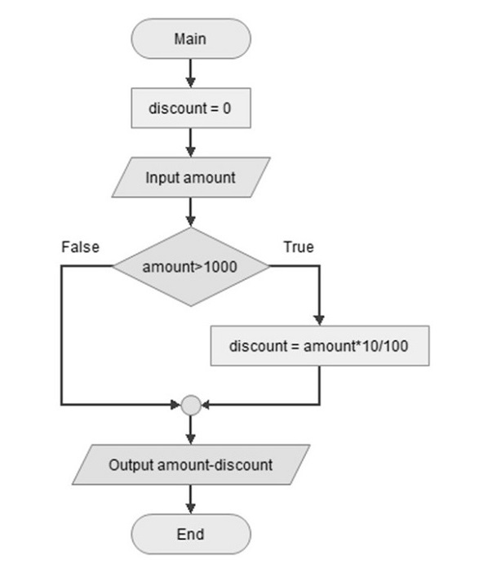
Worked Example
SLIDE 9 / 14
Search Logic
FILE CONTENT
'Hello World', 'Python is great', 'Learn coding today'
TARGET STRING TO SEARCH
'Python'
• Line 1 check: 'Hello World' does not contain 'Python' (False)
• Line 2 check: 'Python is great' contains 'Python' (True)
• Search stops and returns the line number 2 as the match location
• If loop finishes without match, the flag remains False indicating failure
• This logic applies to any text file regardless of the specific content
Source: www.tutorialspoint.com
Chandigarh University
9 / 14
Notes:
Let's trace this logic. We look at the first line, it doesn't have 'Python', so we move on. The second line has 'Python', so we stop and report line 2. If we went through all lines and never found it, we would report that the search failed. This simple logic is the backbone of many search tools.

Slide 10
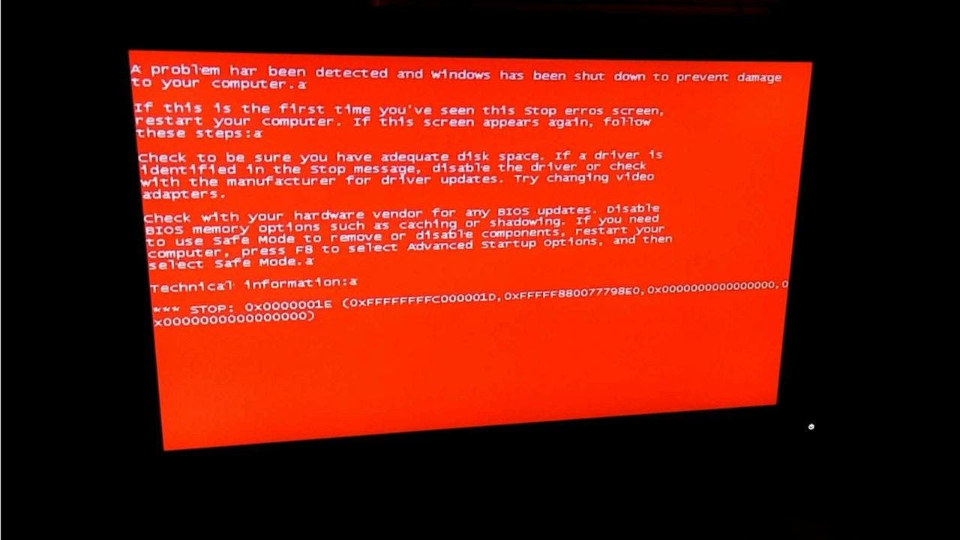
Common Pitfalls
SLIDE 10 / 14
File Not Found
1
Attempting to open a non-existent file in 'r' mode raises a FileNotFoundError
2
The program will crash immediately if this exception is not handled properly
3
Always verify file existence or use try-except blocks for robust error handling
4
Check the file path carefully as it is case-sensitive on Linux systems
5
Ensure the file path is relative to the current working directory of the script
6
Use absolute paths if the file location might change during execution
7
Provide clear error messages to help users understand why the file failed
Source: a57.foxnews.com
Chandigarh University
10 / 14
Notes:
One of the most common errors is trying to read a file that doesn't exist. Python will throw a FileNotFoundError and stop your program. To fix this, you must use a try-except block to catch the error and tell the user what went wrong. Always double-check your file paths, especially on Linux where capitalization matters.

Slide 11
Best Practice
SLIDE 11 / 14
Context Managers
SYNTAX
with open('filename', 'mode') as file_object: ...
• The 'with' statement automatically handles closing the file after the block ends
• It ensures resources are released even if an error occurs during file operations
• This approach eliminates the need for explicit close() calls in your code
• It reduces the risk of file handles remaining open and causing memory leaks
• Context managers are the recommended standard for all file handling in Python
• The file object is available only within the indented block following the with statement
Chandigarh University
11 / 14
Notes:
Think of the 'with' statement as a safety net that guarantees the file is closed, even if your code crashes. It is the modern, recommended way to handle files in Python. You don't need to write the close() command manually, which reduces errors. Always use this pattern for cleaner and safer code.

Slide 12
Lecture
SLIDE 12 / 14
Data Structures for File Content
1
Lists are ideal for storing lines read from a file using readlines()
2
Dictionaries can map keys to values found within structured file data
3
Tuples provide immutable storage for fixed sets of data extracted from files
4
Sets are useful for finding unique words or entries in a large text file
5
Choose the structure based on how you plan to access and process the data
6
Lists allow indexing and modification, while tuples ensure data integrity
7
Converting file data to the right structure simplifies subsequent processing tasks
Chandigarh University
12 / 14
Notes:
Once you read the file, you need to store the data somewhere. Lists are great for ordered lines, while dictionaries are perfect for key-value pairs. Tuples are good if the data shouldn't change, and sets help you find unique items. Choosing the right structure makes your search and manipulation logic much simpler.

Slide 13
Lecture
SLIDE 13 / 14
Key Takeaways
1
File modes determine how you can access and modify file content safely
2
Read methods vary in memory usage and return types for different needs
3
Search logic requires iteration and careful handling of case sensitivity
4
Context managers with 'with' ensure files are closed and resources freed
5
Error handling prevents crashes when files are missing or inaccessible
Chandigarh University
13 / 14
Notes:
To summarize, always choose the right file mode and read method for your specific task. Remember that searching requires iteration and attention to detail. Most importantly, use context managers to keep your code safe and robust. These practices will make you a better Python programmer.

Slide 14
Lecture
SLIDE 14 / 14
References
PYTHON
A Practical Learning Approach, 1st Edition — T.S. Murugesh, Shriram K. Vasudevan, Sini Raj Pulari
• Learning Python, 6th Edition — Mark Lutz
• Starting Out with Python, Global Edition, 6th Edition — Tony Gaddis
• Introduction to Python Programming and Data Structures, 3rd Edition — Y. Daniel Liang
Chandigarh University
14 / 14
Notes:
These four books are excellent resources for deepening your understanding of Python programming. Mark Lutz and Tony Gaddis provide comprehensive guides, while Liang and the team at Chandigarh University offer practical approaches. I encourage you to consult these texts for further study and practice.

